Slide 1
Look! Up in the sky! It's a bird. It's a plane. It's Nanoman!
Aleksandar Nikolic & Jan Egil Ring

Slide 2
Agenda
What is Nano Server?
How could we manage Nano Server?
Demo time
Management techniques
Nano as a Container & Container host
SMT behind the scenes

Slide 3
What is Nano Server?
A new installation option for Windows Server
A server OS optimized for the cloud
Cloud fabric & infrastructure (clustering, storage, networking)
Born-in-the-cloud applications
Virtual machines & containers (Hyper-V and Docker)
No interactive logon, no RDP access

Slide 4
How could we manage Nano Server?
Remote graphical and web-based tools
Server Manager, SMT, SCVMM
PowerShell remoting
CIM Sessions
PowerShell DSC
PowerShell Web Access
PowerShell Direct

Slide 5
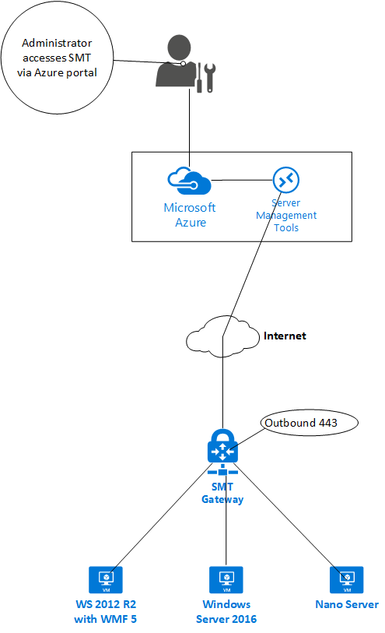
SMT Architecture

Slide 6
Demo
Notes:
Demo 01: Jan (DSC demos)
Demo 02: Alex (SMT Cmdlets)
Demo 03: Jan (SMT Under the Hood)
Demo 04: Alex (Container & Container Host)

Slide 7
Summary
Nano is an optimal operating system for hosting containers
It supports a wide variety of new and excisting management tools

Slide 8
Next Steps...
Now: 15 min break
Grab a coffee
Stay here to enjoy next presentation
Change track and switch to another room
Ask us questions or meet me in a breakout session room afterwards

Slide 9
Questions?

Slide 10
Resources
Slides
github.com/PSConfEU/2017
Other resources
Nano Server: The Future of Windows Server Starts Now
Nano Server Blog
Getting Started with Nano Server
Nano Server Videos on Channel 9
A Deep Dive into Nano Server (MVA Course)
Automatically Configure Your Machines Using Azure Automation DSC at Initial Boot-up

Slide 11
About_Author
Aleksandar Nikolić
PowerShell and Azure trainer
Cloud and Datacenter Management MVP
Microsoft Azure MVP
Co-founder of PowerShellMagazine.com
Jan Egil Ring
Lead Architect, Infrastructure at Crayon
Cloud and Datacenter Management MVP
Member of the editorial board of PowerShellMagazine.com

